Slide 1
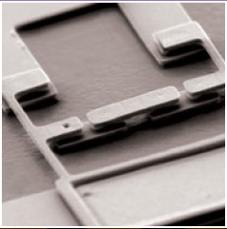
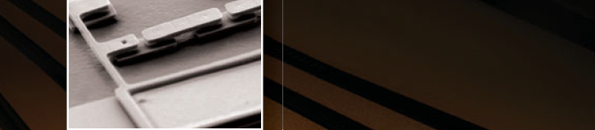
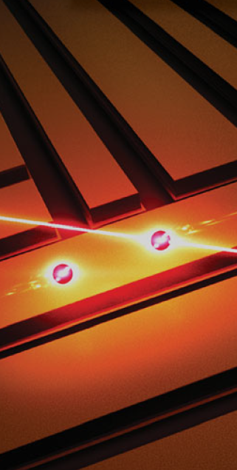

Materials in superconducting quantum bits by William D. Oliver and Paul B. Welander (超導量子位元中的材料)
報告者 : 謝凱閔
指導教授: 邱奎霖 教授

Slide 2
Outline
Introduction
What is a qubit ?
Coherence/decoherence time
Spectacular improvements
Josephson tunnel junctions and two-level systems
Josephson tunnel junctions
Two-level systems
What resonators can tell us about materials and fabrication
Introduction of resonator
SQUIDs and flux(Skip)
Source of noise
Summary

Slide 3
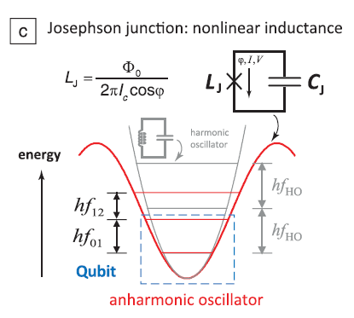
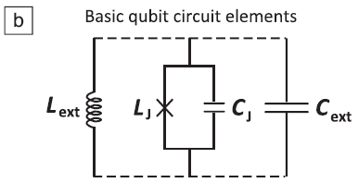
What is a qubit ?
“Superconducting artificial atoms” are electronic circuits.
linear LC resonant circuits + Josephson junction(JJ)

Slide 4
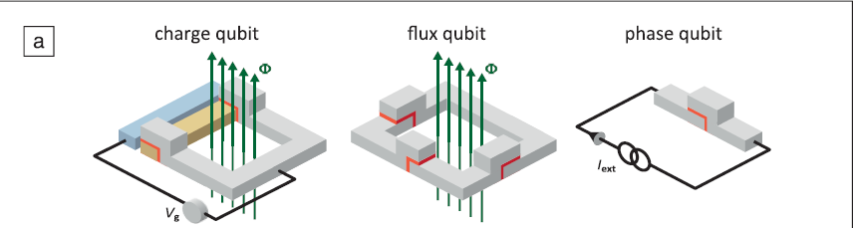
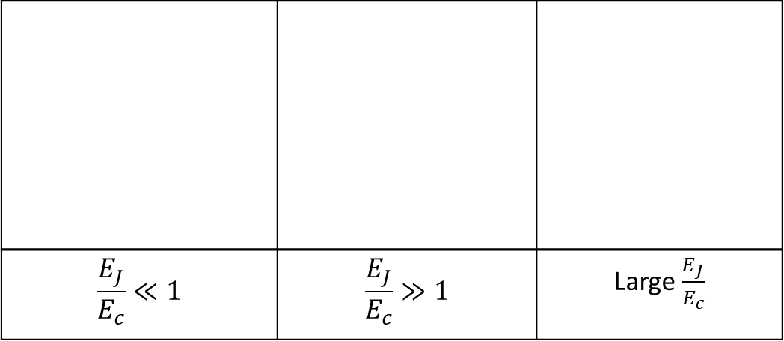
What is a qubit ?
“Superconducting qubit” generally refers to the ground and first-excited state of a superconducting artificial atom.
Two-Level System (TLS)
$$\frac{E_{J}}{E_{c}}≪1$$ | $$\frac{E_{J}}{E_{c}}≫1$$ | Large $\frac{E_{J}}{E_{c}}$

Slide 5
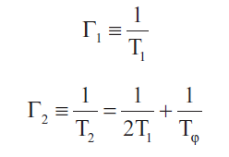
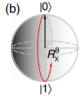
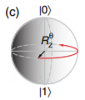

Coherence/decoherence time
The amount of time that qubits stay in the superposition state is referred to as their "coherence time ".
Two characteristic decay rates that contribute to coherence loss:
Γ 1 = longitudinal relaxation rate(energy decay rate)
Γ 2 = transverse relaxation rate (decoherence rate)
T$φ$ =pure dephasing time

Slide 6
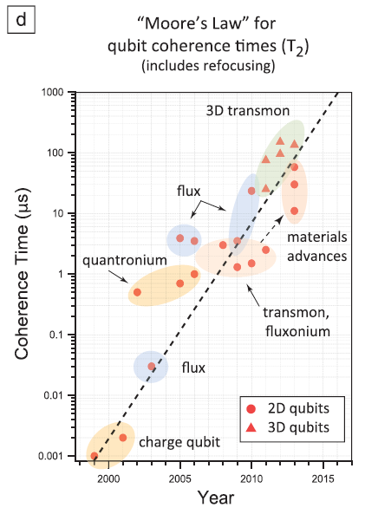
Spectacular improvements
1999, Nakamura et al. : nanosecond-scale coherence in Cooper pair box(charge qubit)
2002, Vion et al. : hundreds of nanoseconds T2 in a modified charge qubit
Burkard et al. : elucidated the importance of symmetry in qubit designs
Bertet et al. : persistent-current flux qubit coherence times into the few microseconds range
In 2005–2006, Ithier et al. and Yoshihara et al. : measured the noise properties of quantronium and flux qubits
Schoelkopf et al. : developed “transmon” qubit
MIT/NEC group : 2D geometry persistent-current flux qubit(20us T2)
Yale group: developed 3D-cavity (100 20us T2)

Slide 7
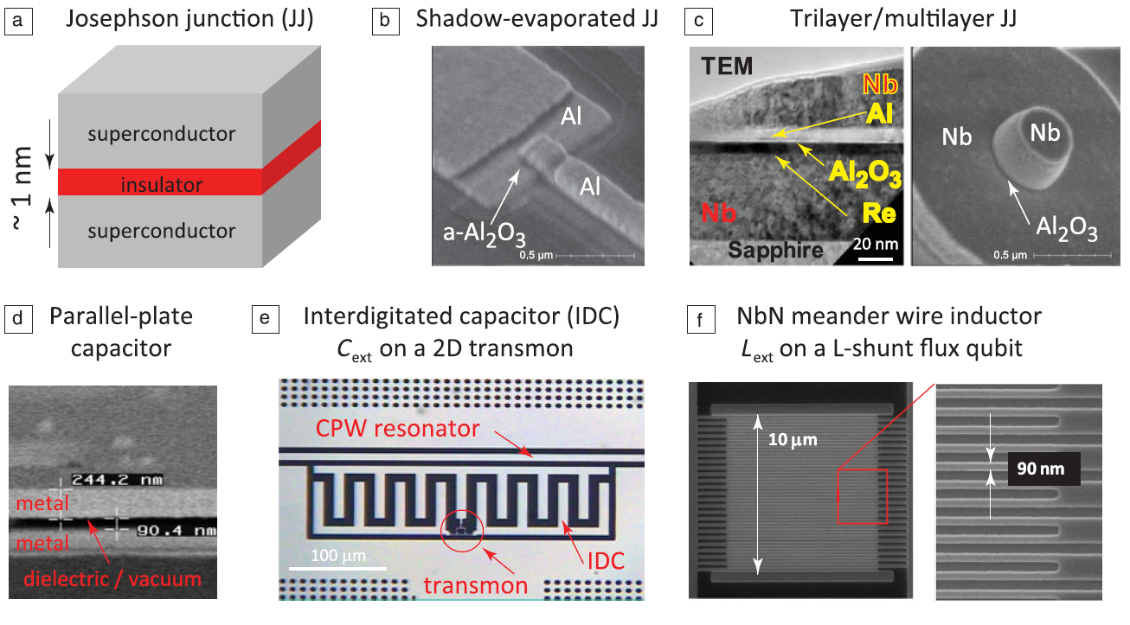
Spectacular improvements

Slide 8
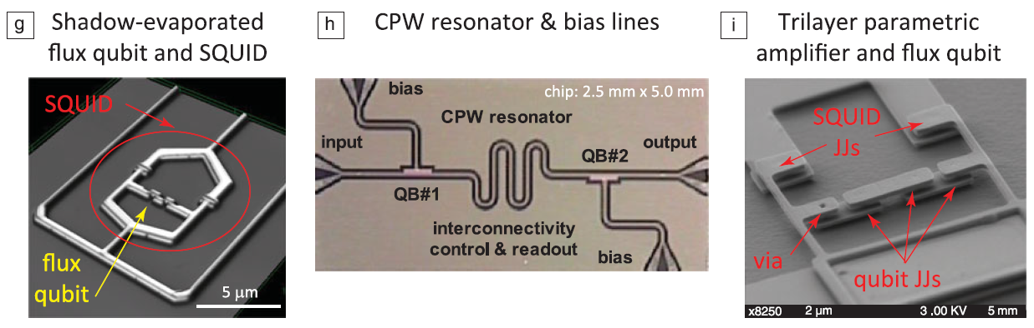
Spectacular improvements

Slide 9
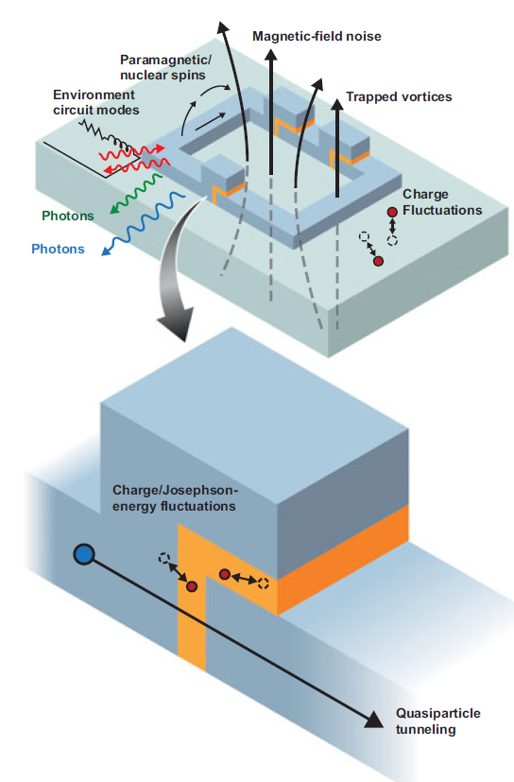
Spectacular improvements
(1) Reduce the qubit’s sensitivity to a given type of noise
Design modifications
(2) Identify and reduce the sources of noise
Materials and Fabrication improvements

Slide 10
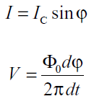
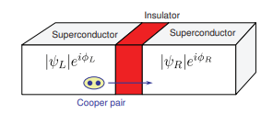


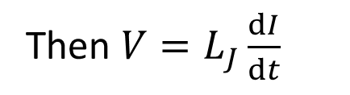
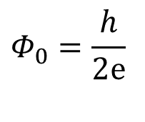
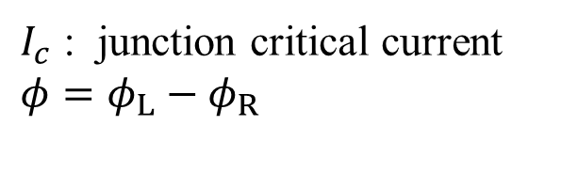
Josephson tunnel junctions
$I_{c}$ : junction critical current
$$φ=φ_{L}−φ_{R}$$
$$Φ_{0}=\frac{h}{2ⅇ}$$
Then $V=L_{J}\frac{ⅆI}{ⅆt}$
Anharmonic oscillator
The parallel-plate-like structure
$$C_{J}$$
Ej : Josephson coupling energy of the junction by $I_{c}=\frac{2ⅇ}{ℏ}E_{j}$
Ec : Electrostatic Coulomb energy $E_{C}=\frac{{\left(2ⅇ\right)}^{2}}{2C}$

Slide 11
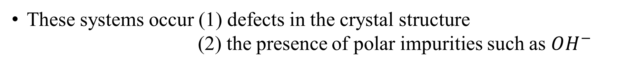
Two-level systems
TLS defects is a localized low-energy excitation that is predominantly found in amorphous materials
These systems occur (1) defects in the crystal structure
(2) the presence of polar impurities such as $OH^{−}$
TLS has a dipole moment that will interact with electromagnetic fields
As the devices cools , TLS are seen as major source of noise and decoherence

Slide 12
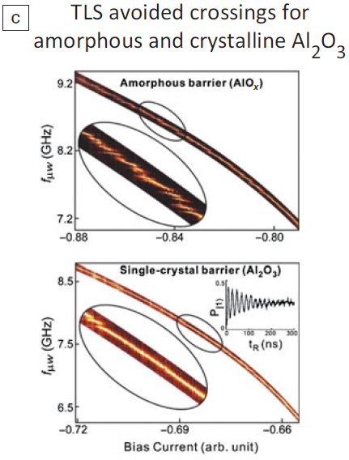
Two-level systems
Two primary ways that TLS in the tunnel barrier can interact with the qubit:
(1) TLS and qubit become coupled
(2) Low-frequency charge fluctuations in
the TLS critical current noise
The spectral splittings occur when the energy-level difference of the qubit matches that of a TLS in the junction barrier

Slide 13
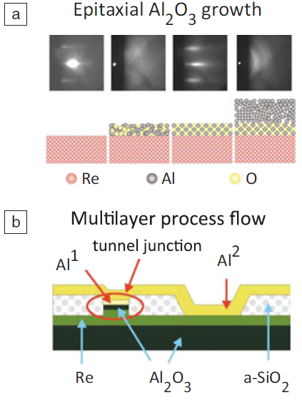
Two-level systems
Reduce TLSs’ impact:
(1) Improving the quality of barrier
(2) Smaller the junctions(0.1~0.3um)
(3) Replace the materials
(4) Change method to grow amorphous
oxide barriers
TLSs in the junction barrier should not be ignored

Slide 14
Introduction of resonator
Resonators identify noise sources and decoherence mechanisms. eg. TLSs
TLSs : (1) Appear in barrier of JJ and dielectric materials used in circuit
(2) Absorb and dissipate energy at low powers and low temperatures,
but will saturate as both voltage and temperature increase
As an increasing loss tangent, tan δ , with decreasing power that plateaus only at very low powers

Slide 15
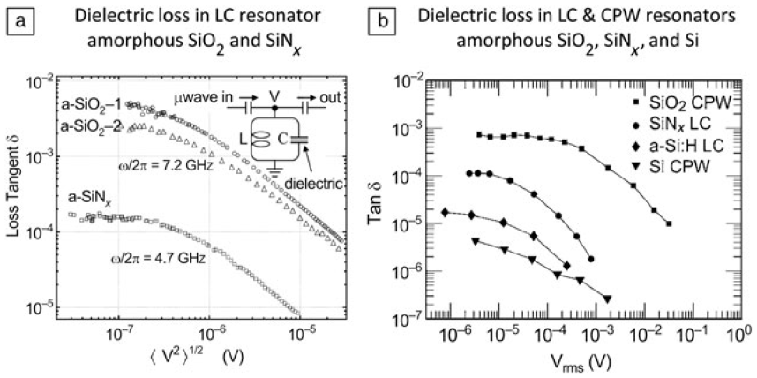
Introduction of resonator
At low powers and temperatures TLSs tend to be in their ground states can absorb energy from the resonator and dissipate that energy via phonon emission, thereby increasing the resonator loss.

Slide 16
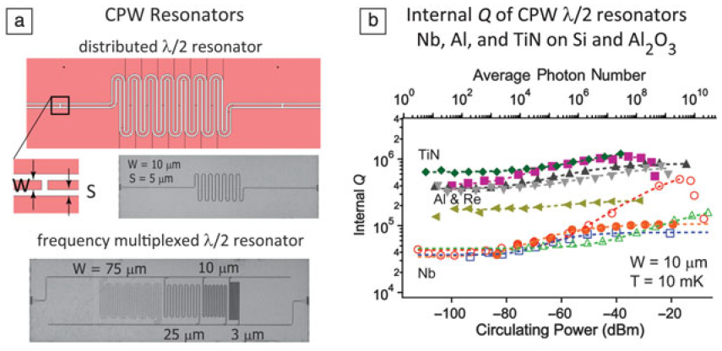
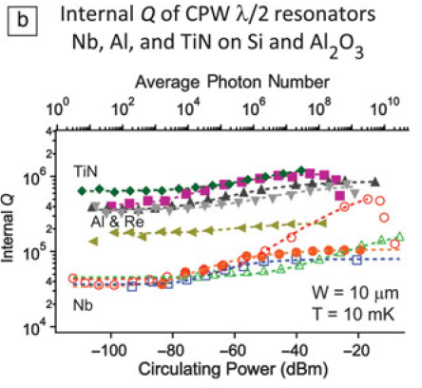
Introduction of resonator
Internal factor : Q
loss (1/ Q )
Resonators are also sensitive to the TLSs that form on metal surfaces and at interfaces between the metal and substrate.
Factors affecting Q quality : (1) Oxide layer on metal surface
(2) Metal-substrate
(3) Substrate-air interfaces
Dominate

Slide 17
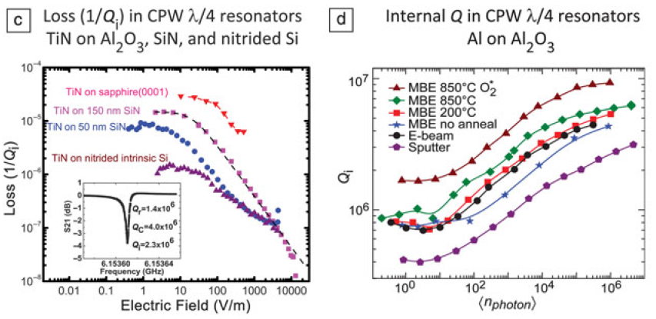
Introduction of resonator
Address the issue of native oxides on metal surfaces
e.g. Fabricate CPW resonators from superconducting nitrides
Address the issue of substrate/superconductor interface
e.g. Films grown on sapphire or on thick SiN layers

Slide 18
Summary
Increasing coherence times by innovations in qubit, device fabrication, and new materials.
Eliminated many TLS sources leading to substantial increases in resonator quality factors and qubit coherence times.
Understanding the effects of decoherence mechanisms such as quasiparticle tunneling or critical current fluctuations are being revisited in more detail.

